Slide 1


Slide 2
Agenda Rsquared Academy
get current date/time
understand date/time classes in R
date arithmetic
time zones and daylight savings
date/time formats
parsing date/time
date/time components
create/update/verify
Intervals, duration and period
Looking for online Data Science training? Call us at +91-9606872504 or visit www.rsquaredacademy.com

Slide 3
Prerequisites Rsquared Academy
basic knowledge of R & RStudio
laptop/desktop
working internet connection
Looking for online Data Science training? Call us at +91-9606872504 or visit www.rsquaredacademy.com

Slide 4
Let’s Begin to Learn Rsquared Academy
Learning Management System
Videos
Slides
Code
Data
Suggested Readings
Need help?
Discussion forum
support@rsquaredacademy.com
+91-9606872504
Raise a ticket
Looking for online Data Science training? Call us at +91-9606872504 or visit www.rsquaredacademy.com

Slide 5
Resources Rsquared Academy
Slides
Code & Data
RStudio Cloud
Online Course
Blog Post
Looking for online Data Science training? Call us at +91-9606872504 or visit www.rsquaredacademy.com

Slide 6
Best Way to Learn Rsquared Academy
Go through the videos
Run the code (locally or on RStudio Cloud)
Experiment with the code
Go through the suggested readings
If you get stuck with the code or have any questions
Use the discussion forum
Mail us @ support@rsquaredacademy.com if you have any questions (We believe no question is naive and every question is important.) and we will try to reply at the earliest.
Looking for online Data Science training? Call us at +91-9606872504 or visit www.rsquaredacademy.com

Slide 7


Slide 8
Current Date/Time Rsquared Academy
Sys.Date() / today()
Sys.time() / now()
am()
pm()
leap_year()
Looking for online Data Science training? Call us at +91-9606872504 or visit www.rsquaredacademy.com

Slide 9
Your Turn... Rsquared Academy
get current date
get current time
check whether the time is in AM or PM?
check whether the following are leap years
2018
2016
Looking for online Data Science training? Call us at +91-9606872504 or visit www.rsquaredacademy.com

Slide 10
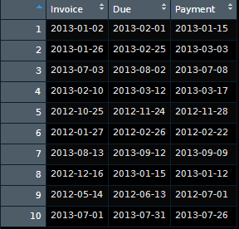
Case Study - Data Rsquared Academy
Looking for online Data Science training? Call us at +91-9606872504 or visit www.rsquaredacademy.com

Slide 11
Case Study Rsquared Academy
extract date, month and year from Due
compute the number of days to settle invoice
compute days over due
check if due year is a leap year
check when due day in february is 29, whether it is a leap year
how many invoices were settled within due date
how many invoices are due in each quarter
what is the average duration between invoice date and payment date
Looking for online Data Science training? Call us at +91-9606872504 or visit www.rsquaredacademy.com

Slide 12


Slide 13
Date & Time Classes Rsquared Academy
Date
POSIXct
POSIXlt
Looking for online Data Science training? Call us at +91-9606872504 or visit www.rsquaredacademy.com

Slide 14
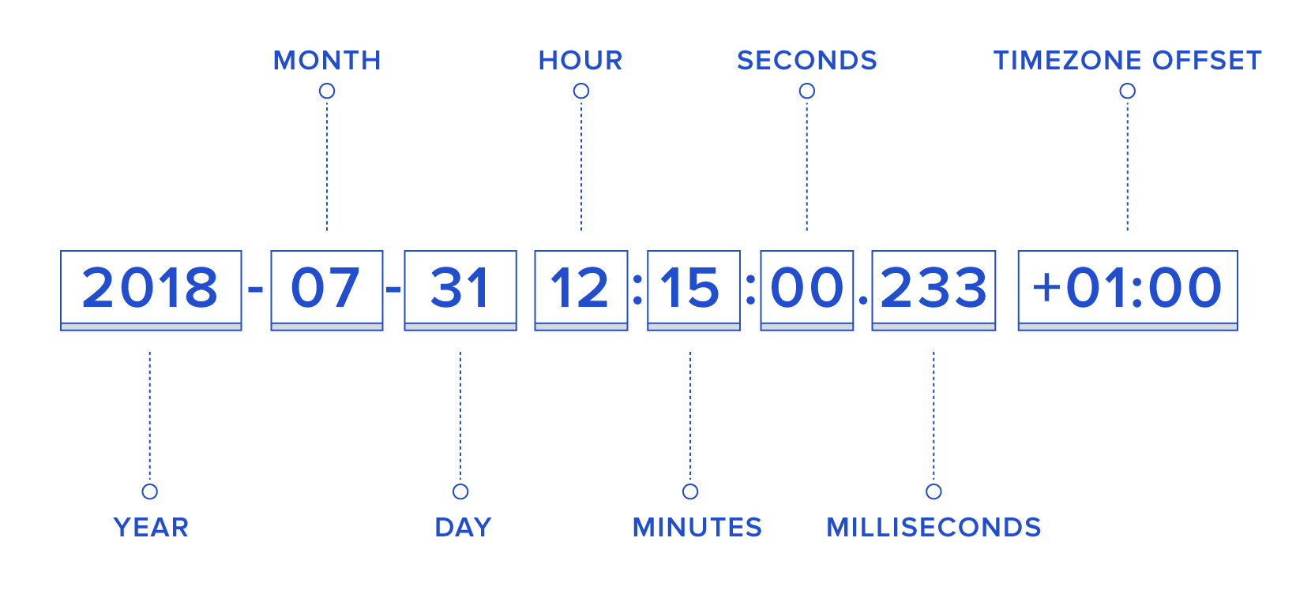
ISO 8601 Standard Rsquared Academy
Looking for online Data Science training? Call us at +91-9606872504 or visit www.rsquaredacademy.com

Slide 15
POSIXlt Rsquared Academy
sec
min
hour
mon
zone
wday
mday
year
yday
ist
gmtoff
Looking for online Data Science training? Call us at +91-9606872504 or visit www.rsquaredacademy.com

Slide 16
Your Turn... Rsquared Academy
R 1.0.0 was released on 2000-02-09 08:55:23 UTC. Save it as
Date
Date using origin
POSIXct
POSIXlt and extract
month day
day of year
month
zone
ISODate
Looking for online Data Science training? Call us at +91-9606872504 or visit www.rsquaredacademy.com

Slide 17


Slide 18
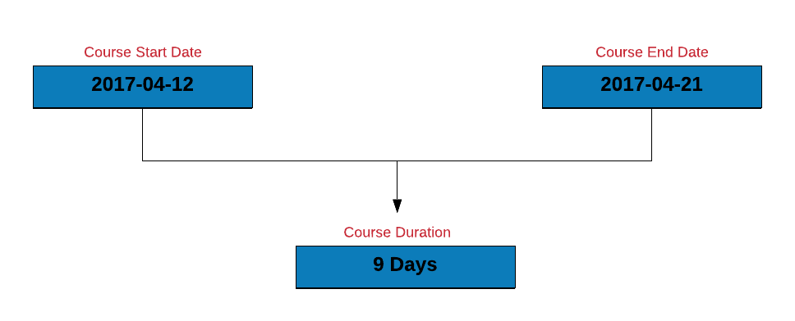
Course Duration Rsquared Academy
Looking for online Data Science training? Call us at +91-9606872504 or visit www.rsquaredacademy.com

Slide 19
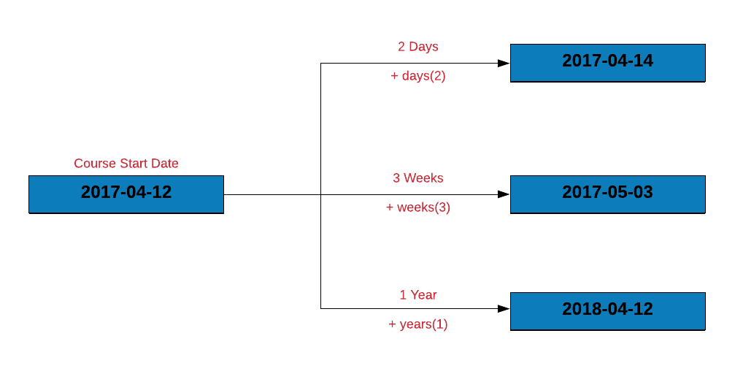
Shift Date Rsquared Academy
Looking for online Data Science training? Call us at +91-9606872504 or visit www.rsquaredacademy.com

Slide 20
Your Turn... Rsquared Academy
compute the length of a vacation which begins on 2020-04-19 and ends on 2020-04-25
recompute the length of the vacation after shifting the vacation start and end date by 10 days and 2 weeks
compute the days to settle invoice and days overdue from the receivables.csv data set
compute the length of employment (only for those employees who have been terminated) from the hr-data.csv data set (use date of hire and termination)
Looking for online Data Science training? Call us at +91-9606872504 or visit www.rsquaredacademy.com

Slide 21


Slide 22

Time Zones Rsquared Academy
Looking for online Data Science training? Call us at +91-9606872504 or visit www.rsquaredacademy.com

Slide 23
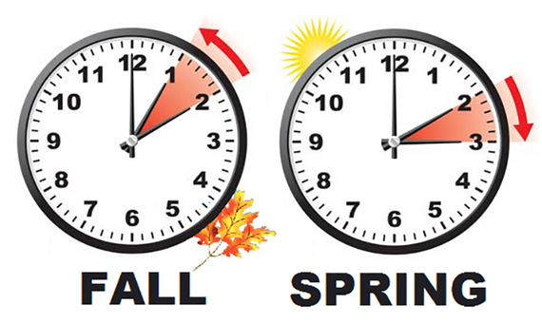
Daylight Savings Rsquared Academy
Looking for online Data Science training? Call us at +91-9606872504 or visit www.rsquaredacademy.com

Slide 24
Your Turn... Rsquared Academy
check the time zone you live in
check if daylight savings is in effect
check the current time in UTC or any other time zone
Looking for online Data Science training? Call us at +91-9606872504 or visit www.rsquaredacademy.com

Slide 25


Slide 26
Formats Rsquared Academy
December 12, 2019
12th Dec, 2019
Dec 12th, 19
12-Dec-19
12 December, 2019
12.12.19
Looking for online Data Science training? Call us at +91-9606872504 or visit www.rsquaredacademy.com

Slide 27
Conversion Specifications Rsquared Academy
Specification | Description | Example
%d | Day of the month (decimal number) | 12
%m | Month (decimal number) | 12
%b | Month (abbreviated) | Dec
%B | Month (full name) | December
%y | Year (2 digit) | 19
%Y | Year (4 digit) | 2019
%H | Hour | 8
%M | Minute | 5
%S | Second | 3
Looking for online Data Science training? Call us at +91-9606872504 or visit www.rsquaredacademy.com

Slide 28
Your Turn... Rsquared Academy
Use conversion specifications to specify the below dates using as.Date()
05.07.19
5-July, 2019
July 5th, 2019
July 05, 2019
2019-July-05
05/07/2019
07/05/2019
7/5/2019
07/5/19
2019-07-05
Looking for online Data Science training? Call us at +91-9606872504 or visit www.rsquaredacademy.com

Slide 29


Slide 30
Parse Date & Time Rsquared Academy
Convert string/character to date using
strptime()
parse_date_time()
Convert date to string character using
strftime()
as.character()
format()
Use helper functions to convert string/character to date without using conversion specifications.
Looking for online Data Science training? Call us at +91-9606872504 or visit www.rsquaredacademy.com

Slide 31
Your Turn... Rsquared Academy
Parse the below dates using strptime()/parse_date_time() or appropriate helper functions:
05.07.19
5-July, 2019
July 5th, 2019
July 05, 2019
2019-July-05
05/07/2019
07/05/2019
7/5/2019
07/5/19
2019-07-05
Looking for online Data Science training? Call us at +91-9606872504 or visit www.rsquaredacademy.com

Slide 32


Slide 33
Components Rsquared Academy
year
month
date
week
day
quarter
semester
hour
minute
second
timezone
Looking for online Data Science training? Call us at +91-9606872504 or visit www.rsquaredacademy.com

Slide 34
Year, Month & Week Rsquared Academy
Function | Description
year() | Get year
month() | Get month (number)
month(label = TRUE) | Get month (abbreviated name)
month(abbr = FALSE) | Get month (full name)
months() | Get month
week() | Get week
Looking for online Data Science training? Call us at +91-9606872504 or visit www.rsquaredacademy.com

Slide 35
Day Rsquared Academy
Function | Description
day() | Get day
mday() | Day of the month
wday() | Day of the week
qday() | Day of quarter
yday() | Day of year
weekdays() | Day of week
days_in_month() | Days in the month
Looking for online Data Science training? Call us at +91-9606872504 or visit www.rsquaredacademy.com

Slide 36
HMS Rsquared Academy
Function | Description
hour() | Get hour
minute() | Get minute
second() | Get second
seconds() | Number of seconds since 1970-01-01
Looking for online Data Science training? Call us at +91-9606872504 or visit www.rsquaredacademy.com

Slide 37
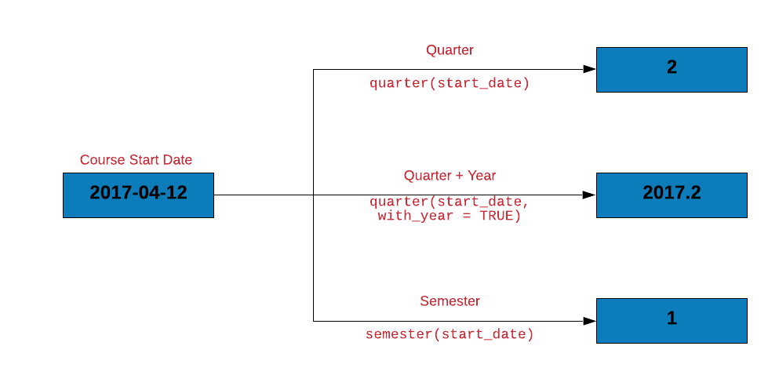
Quarter & Semester Rsquared Academy
Looking for online Data Science training? Call us at +91-9606872504 or visit www.rsquaredacademy.com

Slide 38
Quarter & Semester Rsquared Academy
Function | Description
quarter() | Get quarter
quarter(with_year = TRUE) | Quarter with year
quarter(fiscal_start = 4) | Fiscal starts in April
quarters() | Get quarter
semester() | Get semester
Looking for online Data Science training? Call us at +91-9606872504 or visit www.rsquaredacademy.com

Slide 39
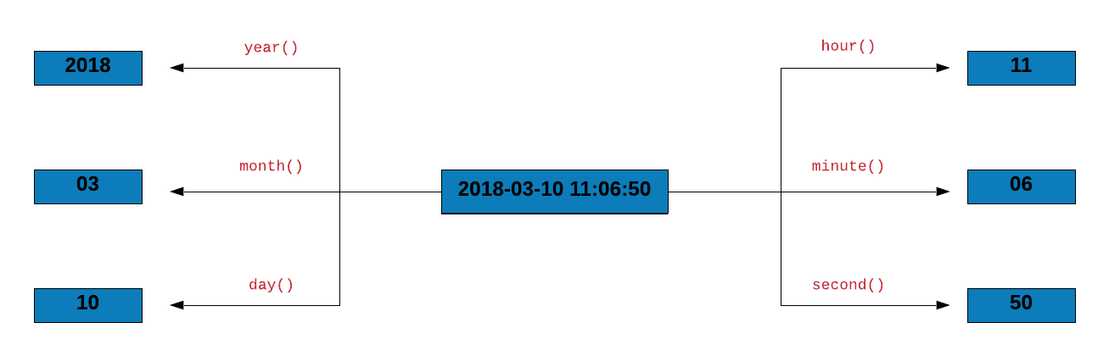
Case Study - Components Rsquared Academy
Looking for online Data Science training? Call us at +91-9606872504 or visit www.rsquaredacademy.com

Slide 40
Case Study - Data Sanitization Rsquared Academy
Let us do some data sanitization. If the due day happens to be February 29, let us ensure that the due year is a leap year. Below are the steps to check if the due year is a leap year:
we will extract the following from the due date:
day
month
year
we will then create a new column is_leap which will have be set to TRUE if the year is a leap year else it will be set to FALSE
filter all the payments due on 29th Feb
select the following columns:
Due
is_leap
Looking for online Data Science training? Call us at +91-9606872504 or visit www.rsquaredacademy.com

Slide 41
Your Turn... Rsquared Academy
Get the R release dates using r_versions() from the rversions package and tabulate the following
year
month with label
weekday with label
hour
and quarter
Looking for online Data Science training? Call us at +91-9606872504 or visit www.rsquaredacademy.com

Slide 42


Slide 43
Create, Update & Verify Rsquared Academy
make_date()
make_datetime()
update()
Looking for online Data Science training? Call us at +91-9606872504 or visit www.rsquaredacademy.com

Slide 44
Date Sequence Rsquared Academy
Function | Description
from | Starting date of the sequence
by | End date of the sequence
to | Date increment of the sequence
length.out | Length of the sequence
along.with | Use length of this value as length of sequence
Looking for online Data Science training? Call us at +91-9606872504 or visit www.rsquaredacademy.com

Slide 45
Your Turn... Rsquared Academy
R 2.0.0 was released on 2004-10-04 14:24:38. Create this date using
make_date()
make_datetime()
and update to 2013-04-03 07:12:36 (R 3.0.0 release date)
Looking for online Data Science training? Call us at +91-9606872504 or visit www.rsquaredacademy.com

Slide 46


Slide 47
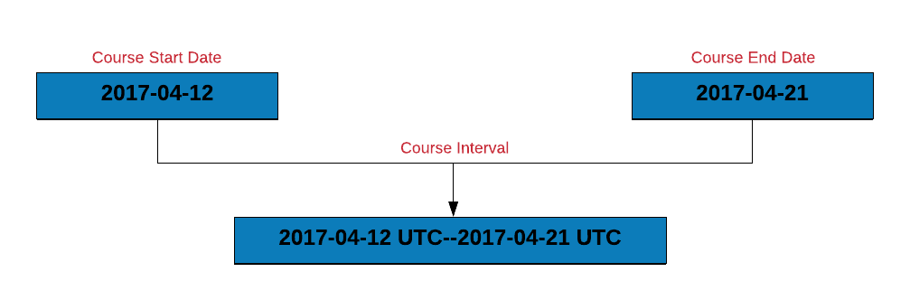
Interval Rsquared Academy
Looking for online Data Science training? Call us at +91-9606872504 or visit www.rsquaredacademy.com

Slide 48
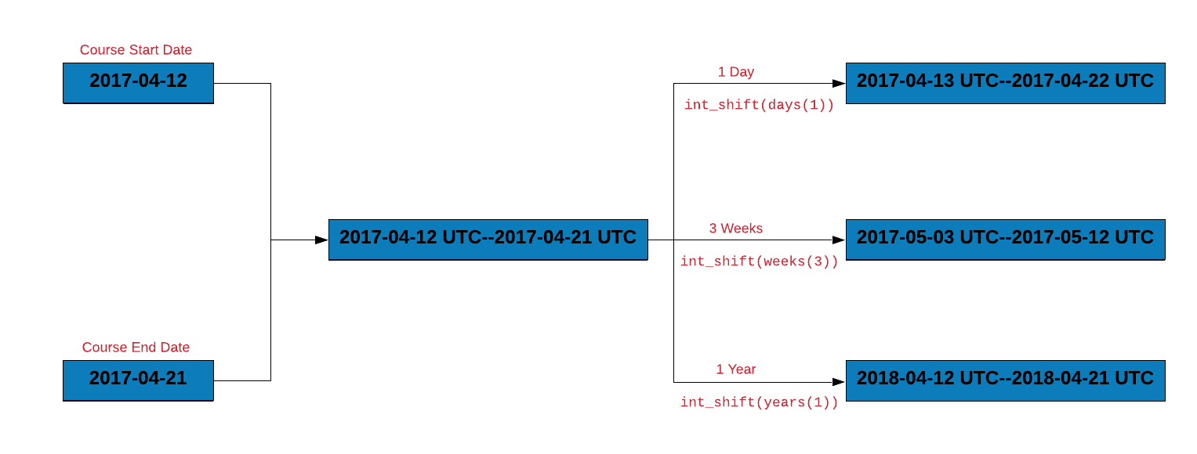
Shift Interval Rsquared Academy
Looking for online Data Science training? Call us at +91-9606872504 or visit www.rsquaredacademy.com

Slide 49
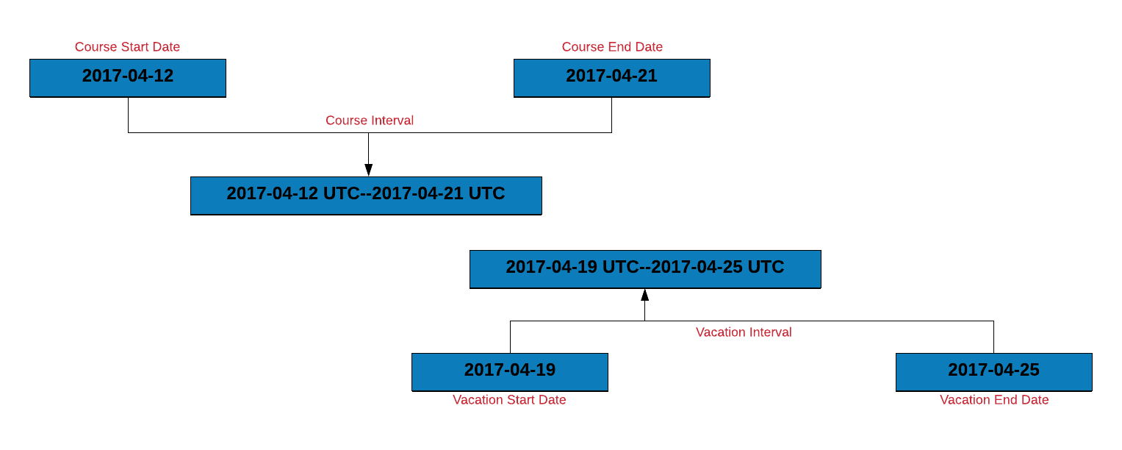
Interval Overlap Rsquared Academy
Looking for online Data Science training? Call us at +91-9606872504 or visit www.rsquaredacademy.com

Slide 50
Case Study Rsquared Academy
Let us use intervals to count the number of invoices that were settled within the due date. To do this, we will:
create an interval for the invoice and due date
create a new column due_next by incrementing the due date by 1 day
another interval for due_next and the payment date
if the intervals overlap, the payment was made within the due date
Looking for online Data Science training? Call us at +91-9606872504 or visit www.rsquaredacademy.com

Slide 51
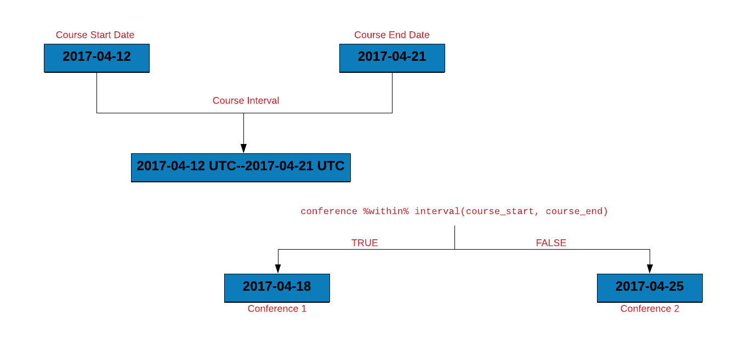
Within Rsquared Academy
Looking for online Data Science training? Call us at +91-9606872504 or visit www.rsquaredacademy.com

Slide 52
Within Rsquared Academy
Let us use %within% to count the number of invoices that were settled within the due date. We will do this by:
creating an interval for the invoice and due date
check if the payment date falls within the above interval
Looking for online Data Science training? Call us at +91-9606872504 or visit www.rsquaredacademy.com

Slide 53
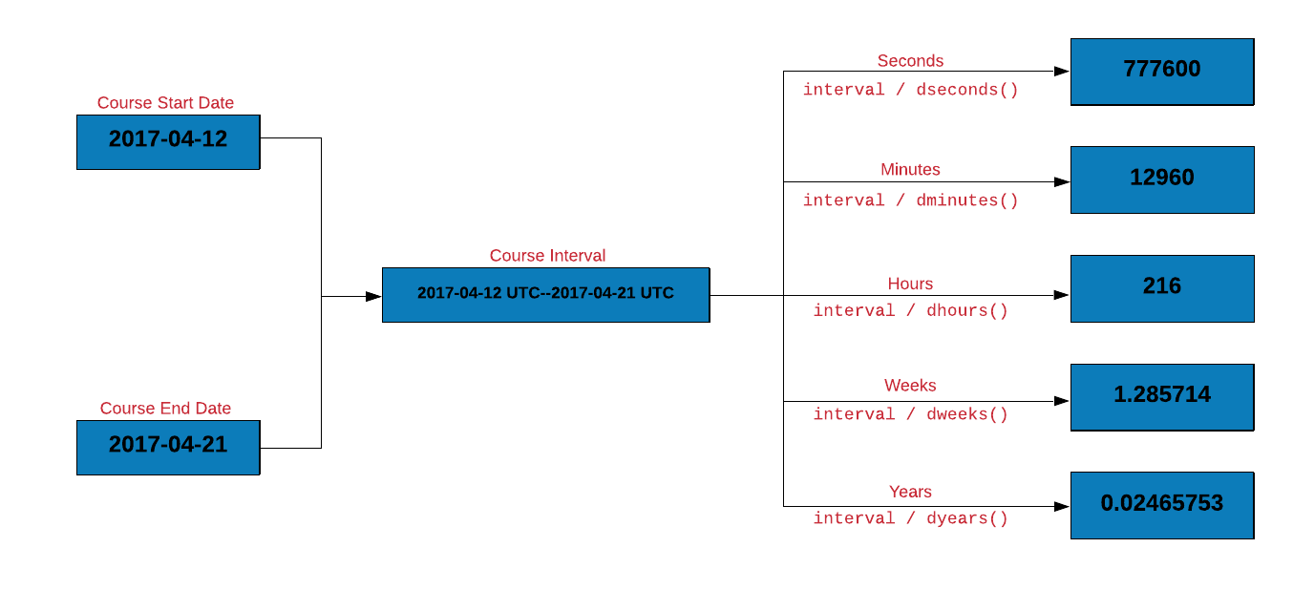
Duration Rsquared Academy
Looking for online Data Science training? Call us at +91-9606872504 or visit www.rsquaredacademy.com

Slide 54
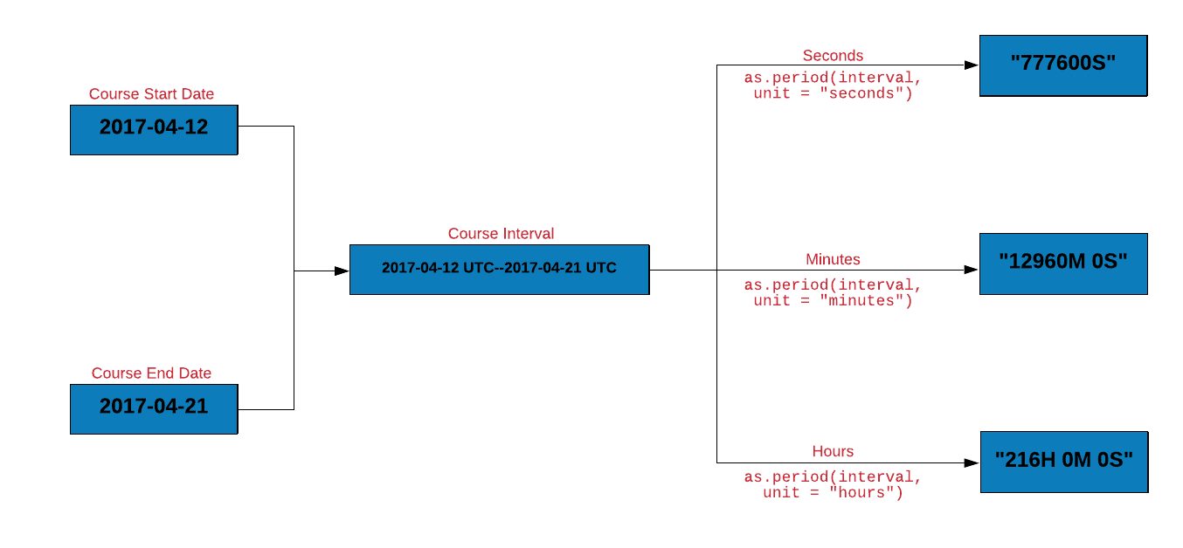
Period Rsquared Academy
Looking for online Data Science training? Call us at +91-9606872504 or visit www.rsquaredacademy.com

Slide 55
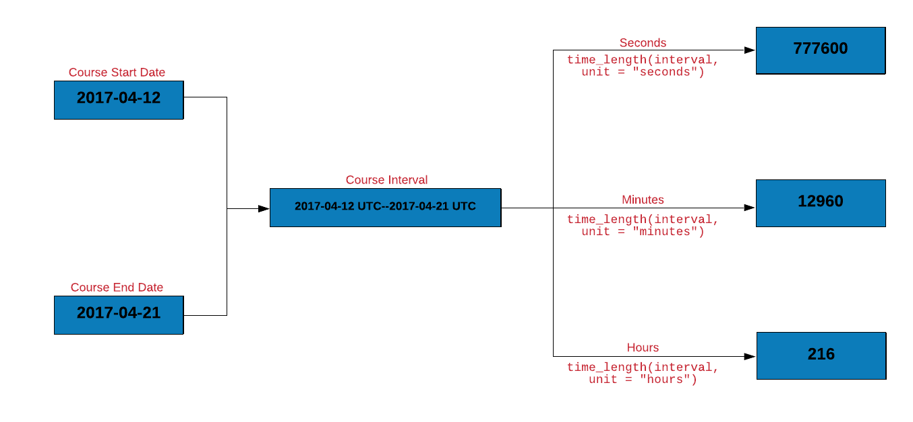
Time Length Rsquared Academy
Looking for online Data Science training? Call us at +91-9606872504 or visit www.rsquaredacademy.com

Slide 56


Slide 57
Rounding Dates Rsquared Academy
We will explore functions for rounding dates
to the nearest value using round_dates()
down using floor_date()
up using ceiling_date()
Looking for online Data Science training? Call us at +91-9606872504 or visit www.rsquaredacademy.com

Slide 58
Rounding Dates Rsquared Academy
The unit for rounding can be any of the following:
second
minute
hour
day
week
month
bimonth
quarter
season
halfyear
and year
Looking for online Data Science training? Call us at +91-9606872504 or visit www.rsquaredacademy.com

Slide 59
Your Turn... Rsquared Academy
round up R release dates to hours
round down R release dates to minutes
rollback R release dates to the beginning of the month
Looking for online Data Science training? Call us at +91-9606872504 or visit www.rsquaredacademy.com

Slide 60
References Rsquared Academy
https://lubridate.tidyverse.org/
https://r4ds.had.co.nz/dates-and-times.html
https://en.wikipedia.org/wiki/Daylight_saving_time
https://en.wikipedia.org/wiki/Time_zone
https://www.worldtimebuddy.com/
https://en.wikipedia.org/wiki/POSIX
Looking for online Data Science training? Call us at +91-9606872504 or visit www.rsquaredacademy.com

Slide 61
Connect With Us Rsquared Academy
Website
Free Online R Courses
R Packages
Shiny Apps
Blog
GitHub
YouTube
Twitter
Facebook
Linkedin
Looking for online Data Science training? Call us at +91-9606872504 or visit www.rsquaredacademy.com

Slide 62


